Slide 1
Technology Transformation Project
Patrick Desbrow
Improve Phase Tollgate Review

Slide 2
BPM Project Summary
Problem Statement
The Client System Group (CSG) spends approximately 277 hours or $25,000 to deliver a single study on the existing Compass web deliverable.
There are too many individual steps in a single study. The existing process is manual and requires a great deal of checking to ensure accuracy. In addition, it is also susceptible to errors and potential rework.
Metric
Y1: Labor hours per syndicated study
Defect Definition
D1: Total time > Labor Hours
D2: # of Errors
Objective
Currently a syndicated study in the Financial Services and Insurance (FS&I) practice area takes approximately 277 hours of IT labor to deliver on the Compass web site. The aim is to:
  Decrease this by 72% or 200 hours of labor for a syndicated research study.
Current Baseline
  Average labor hours for creating and checking study deliverables: 277 labor hours
  2.0 person programming teams work on each study implementation
  All hardware and software costs are part of the Solution Framework project
Projected Benefits
  Based on project chargeback rates per hour, There will be a cost saving of $15,433 per study implementation
  There is at least $100,000 savings if only seven to nine current insurance practice area studies move over to this new process
Copyright © 2001-2007
Six Sigma Academy International, LLC
All Rights Reserved
JDPA – Insurance Practice Business Process Redesign

Slide 3
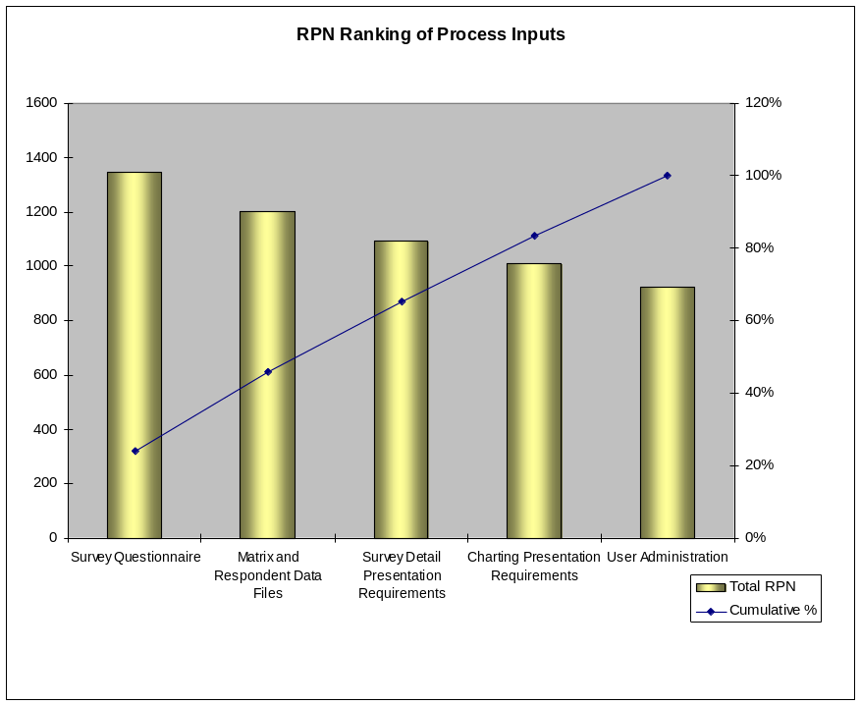
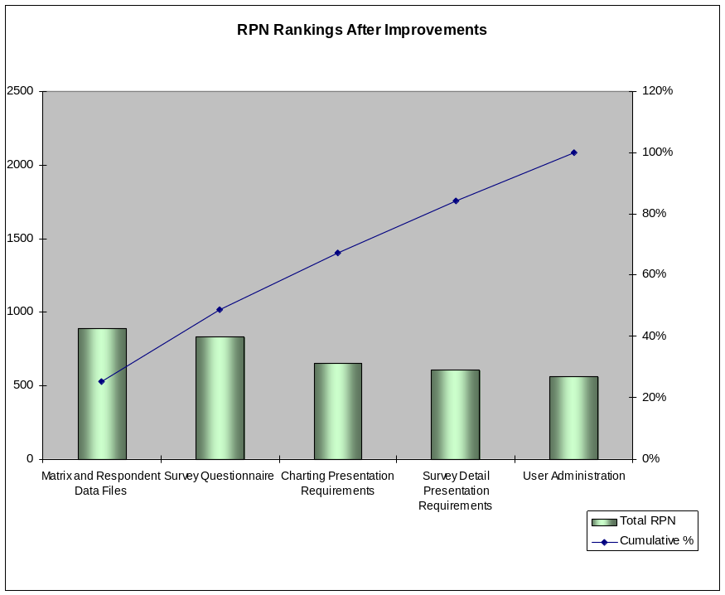
Failure Modes and Effects Analysis (FMEA)
The project team conducted a Failure Modes and Effects Analysis (FMEA) to assess the impact of certain process inputs on a study’s labor hours
  Process inputs that only impact client deliverable production were assessed
  Each process input was analyzed to see what could go wrong; the failures result in additional time/resources/labor
  The assessment assigned a ‘Risk Priority Number’ (RPN) to a process input does not perform as designed or expected (i.e. when a process input fails); the RPN is based on the team’s ratings of:
    Severity – What is the impact to the customer (internal or external)?
    Occurrence – What is the frequency of failure cause?
    Detection – What is the likelihood that the cause would not be detected?
Efficiency for producing client files/analysis inputs is expected to improve as a result of the R2T2 solution
Copyright © 2001-2007
Six Sigma Academy International, LLC
All Rights Reserved
JDPA – Insurance Practice Business Process Redesign

Slide 4
Improve Findings
The drivers that can reduce labor hours
  Requirements gathering steps
  Data loading steps
  Creation of the web site presentation
Other drivers of waste
  There are a number of communication steps
  Process is managed by IT project managers
  Data is load several times
  Requirements changes throughout a studies lifecycle until published
Extensive data verification is required due to the manually intensive processes involved
Copyright © 2001-2007
Six Sigma Academy International, LLC
All Rights Reserved
JDPA – Insurance Practice Business Process Redesign

Slide 5
Recommendations
Reduce or eliminate the manual steps in the current process
  Gather requirement
  Loading data
  Creation of presentation deliverables (charts, reports, etc…)
Standard common functions to remove the need for manual intervention in the process
Propose and test the development of back-office tools to automate the new process
Examine the quality metrics for each study to verify that quality does up when the recommended improvements put in place
Copyright © 2001-2007
Six Sigma Academy International, LLC
All Rights Reserved
JDPA – Insurance Practice Business Process Redesign

Slide 6
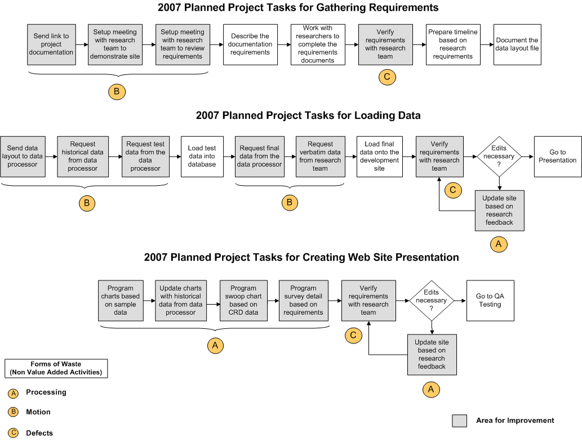
Current State – Process Map
30 Hrs (75%) of the time spent gathering requirements is non value added activities.
30 Hrs (75%) of the time spend loading data is non value added activities.
60 Hrs (75%) of the time spend creating the web site presentation is non value added activities.
There are a number of areas for improvement
The gray boxes emphasize the need for a new process and new tools that support automation.
Copyright © 2001-2007
Six Sigma Academy International, LLC
All Rights Reserved
JDPA – Insurance Practice Business Process Redesign

Slide 7
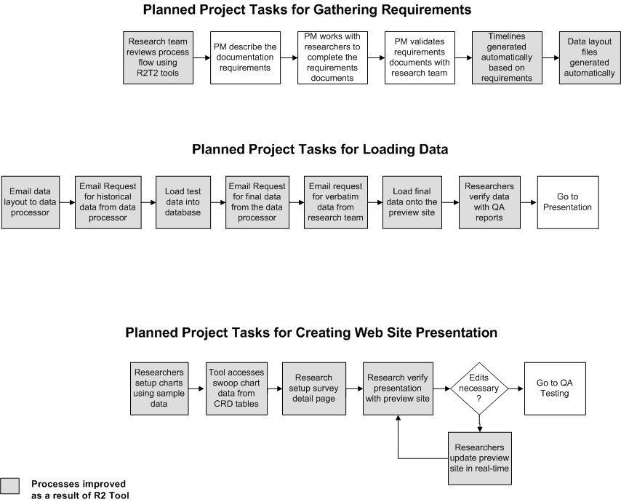
Future State – Process Map
30 Hrs (75%) of the time spent gathering requirements has been removed from the process.
30 Hrs (75%) of the time spend loading data has been removed from the process.
60 Hrs (75%) of the time spend creating the web site presentation has been removed from the process.
Copyright © 2001-2007
Six Sigma Academy International, LLC
All Rights Reserved
JDPA – Insurance Practice Business Process Redesign

Slide 8
Next Steps
Project Task Owner Target Date
Web Site Version 1 02/061/09
- Process Flow Dashboard IT Complete
- Matrix File Discrepancy Page IT Complete
- Finalize Reporting & Chart Documentation Research Complete
- Survey Detail/Quex Properties Page IT Complete
Web Site Version 2 03/07/09
- Index Model Reporting Page IT Completed
- Portal Publishing Page IT Completed
- Data Import Page IT Completed
- Charting Definition Page IT Completed
- Data Export Page IT Completed
Web Site Auditing and Validation Research 03/19/09
BPM Control Phase/Handoff BPM Team 3/30/09
Copyright © 2001-2007
Six Sigma Academy International, LLC
All Rights Reserved
JDPA – Insurance Practice Business Process Redesign

Slide 9
APPENDIX
Copyright © 2001-2007
Six Sigma Academy International, LLC
All Rights Reserved
JDPA – Insurance Practice Business Process Redesign

Slide 10
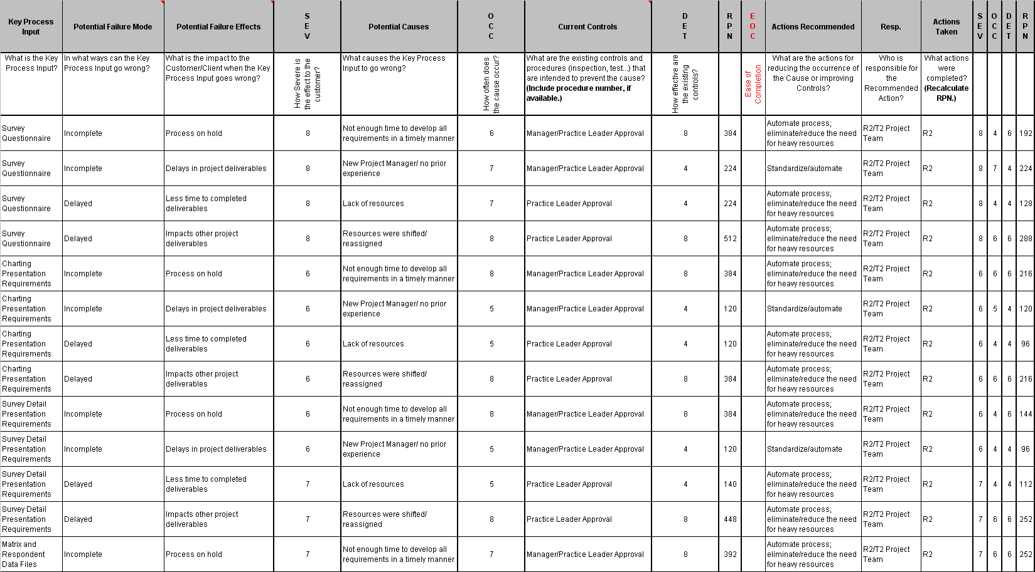
FMEA
Copyright © 2001-2007
Six Sigma Academy International, LLC
All Rights Reserved
JDPA – Insurance Practice Business Process Redesign

Slide 11
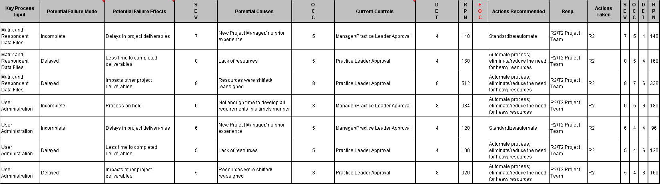
FMEA (continued)
Copyright © 2001-2007
Six Sigma Academy International, LLC
All Rights Reserved
JDPA – Insurance Practice Business Process Redesign

Slide 12
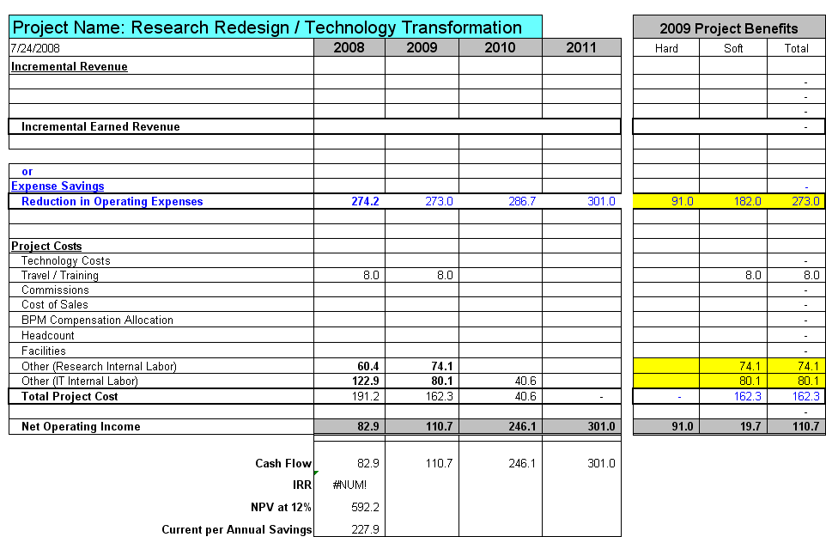
JDPA Business Revised Case Summary
Note: All numbers are in thousands (000)
Copyright © 2001-2007
Six Sigma Academy International, LLC
All Rights Reserved
JDPA – Insurance Practice Business Process Redesign

Slide 13
Revised Assumptions
Labor Improvement Assumptions
Improvement in IT labor hours (72%) associated with the following activities:
  Reducing project management
  Eliminating data loading tasks
  Reduce chart creating and presentation tasks
Cost Savings Assumptions
Total saving in 2008 was $ 274,172 across all studies that used the new process
  $13,000 cost saving per study – see 2008 actual cost data (was $15,433 per study)
20 projects in 2008, 20 projects each year after (was 4 projects in 2008, 25 each year after).
Resource Assumptions
FS&I research labor costs of $70,591 moved from 2008 to 2009 due to a late start in the project
FS&I IT contractor costs of $39,549 moved from 2008 to 2009 due to late start in the project added to existing 2009 $40K cost estimate
33% of the contract resources will be retired resulting in a hard cost saving of $91,000 in 2009
All other resources will moved to other projects
Other Assumptions
Assume 5% labor escalation and no project activity increases in the future years.
Travel: $1000/trip x 2 trips x 2 employees = $4,000
Training: $1,000/session x 4 sessions = $4,000
No software or hardware costs. (These costs are part of the Solution Framework project)
Copyright © 2001-2007
Six Sigma Academy International, LLC
All Rights Reserved
JDPA – Insurance Practice Business Process Redesign

Slide 14
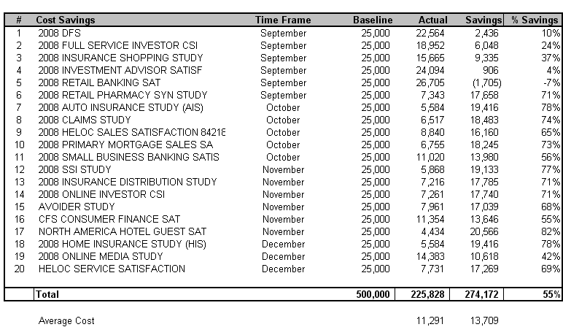
2008 Actual Cost
6.
20 studies where executed in 2008. As a result, there was a total of $274,172 or 55% saving across these studies. This is an average of over $13,000 per study. This allows time for researchers to create additional value in their deliverables.
Source: Full labor hours capture through Timepiece. Contract labor hours captured through ActTime
Copyright © 2001-2007
Six Sigma Academy International, LLC
All Rights Reserved
JDPA – Insurance Practice Business Process Redesign
Notes:
The initial project charter was still rather broad – identifying a need for improvement within the broad spectrum of executing a mail-based study. In that regard, it was important for us to walk through the process and talk to process owners, practice leads, and research project managers to identify the key stakeholders and internal customers. This helped us understand the pain points throughout the process
From the walk-through and interviews, we learned a few things:
1. The existence of a number of handoffs and verification steps that have been institutionalized in our processes
2. An understanding of how scope of work changes and input variation impact our Client Operations (i.e. research production) activities, and
3. The type of data available and necessary for us to gather and analyze in order to prioritize our pain points

Slide 15
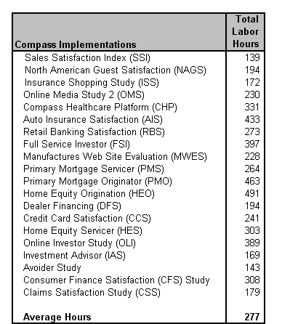
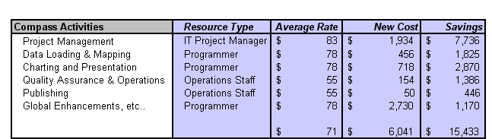
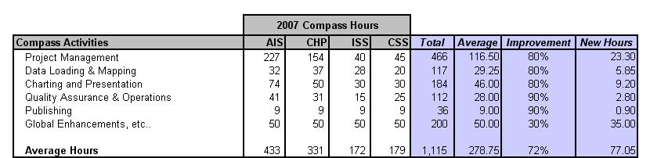
Baseline Data
1.
3.
There will be a cost saving of $15,433 per study implementation
4 high profile studies (AIS, CHP, ISS, CSS) were selected as a sample for analysis.
An average of 277 hours are spent on activities related to compass implements
2.
Project Management, Data Loading, and Presentation tasks are the drivers of cost
Source: Full labor hours capture through Timepiece. Contract labor hours captured through ActTime
Copyright © 2001-2007
Six Sigma Academy International, LLC
All Rights Reserved
JDPA – Insurance Practice Business Process Redesign
Notes:
The initial project charter was still rather broad – identifying a need for improvement within the broad spectrum of executing a mail-based study. In that regard, it was important for us to walk through the process and talk to process owners, practice leads, and research project managers to identify the key stakeholders and internal customers. This helped us understand the pain points throughout the process
From the walk-through and interviews, we learned a few things:
1. The existence of a number of handoffs and verification steps that have been institutionalized in our processes
2. An understanding of how scope of work changes and input variation impact our Client Operations (i.e. research production) activities, and
3. The type of data available and necessary for us to gather and analyze in order to prioritize our pain points

Slide 16
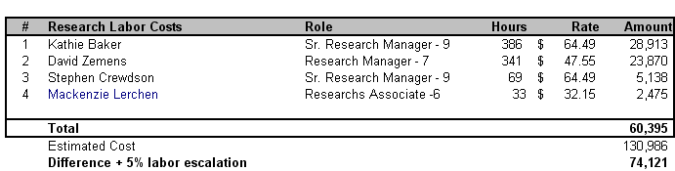
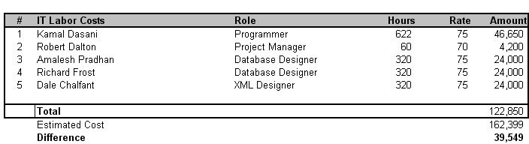
2008 Actual Cost
4.
$ 70,591 in cost was moved from 2008 to 2009 due to a late start in the project
5.
$ 39,549 in cost was moved from 2008 to 2009 due to a late start in the project
Source: Full labor hours capture through Timepiece. Contract labor hours captured through ActTime
Copyright © 2001-2007
Six Sigma Academy International, LLC
All Rights Reserved
JDPA – Insurance Practice Business Process Redesign
Notes:
The initial project charter was still rather broad – identifying a need for improvement within the broad spectrum of executing a mail-based study. In that regard, it was important for us to walk through the process and talk to process owners, practice leads, and research project managers to identify the key stakeholders and internal customers. This helped us understand the pain points throughout the process
From the walk-through and interviews, we learned a few things:
1. The existence of a number of handoffs and verification steps that have been institutionalized in our processes
2. An understanding of how scope of work changes and input variation impact our Client Operations (i.e. research production) activities, and
3. The type of data available and necessary for us to gather and analyze in order to prioritize our pain points

Slide 17


2008 Actual Cost
7.
$13,000 was established as the revised baseline cost saving per studies after reviewing the 20 studies that where executed in 2008. The $13,000 was then adjusted based on the 5% labor escalation assumption.
If these cost saving where applied to all of the 74 projects scheduled to be completed in 2009 then total saving would be over $1,000,000 per year.
These cost saving will be documented in subsequent BPM green belt projects.
Source: Full labor hours capture through Timepiece. Contract labor hours captured through ActTime
Copyright © 2001-2007
Six Sigma Academy International, LLC
All Rights Reserved
JDPA – Insurance Practice Business Process Redesign
Notes:
The initial project charter was still rather broad – identifying a need for improvement within the broad spectrum of executing a mail-based study. In that regard, it was important for us to walk through the process and talk to process owners, practice leads, and research project managers to identify the key stakeholders and internal customers. This helped us understand the pain points throughout the process
From the walk-through and interviews, we learned a few things:
1. The existence of a number of handoffs and verification steps that have been institutionalized in our processes
2. An understanding of how scope of work changes and input variation impact our Client Operations (i.e. research production) activities, and
3. The type of data available and necessary for us to gather and analyze in order to prioritize our pain points

